Slide 1
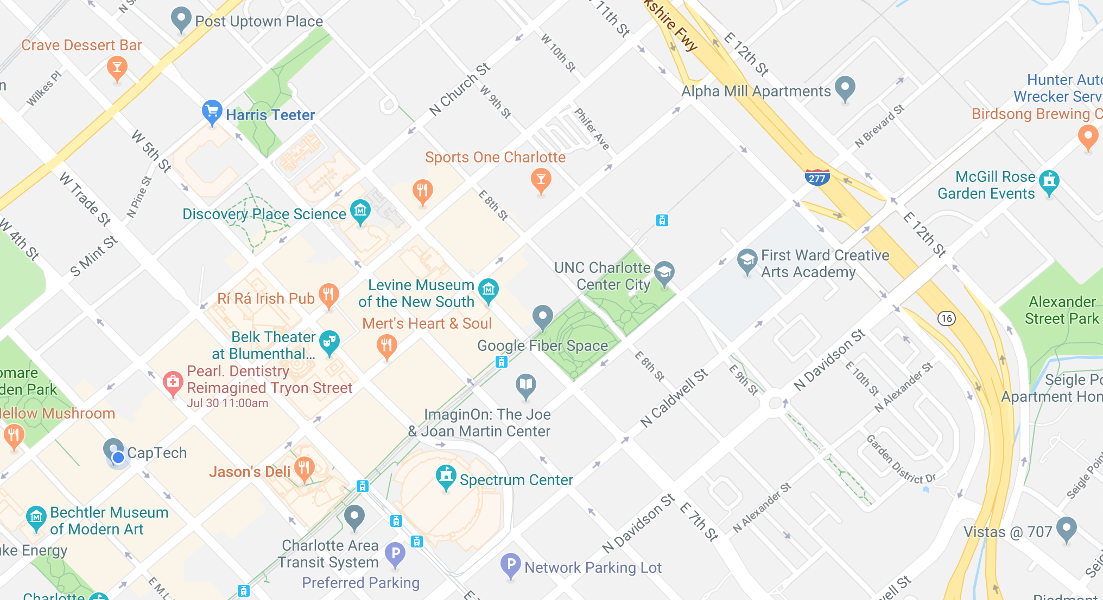


Slide 2
Google Maps APIs – What data did we use?
Navigation steps
Start coordinate
End coordinate
Distance
Duration
Possible meeting places
Notes:
Adam

Slide 3
Google Maps APIs
Directions API
Returns array of Step objects
Required parameters
Origin
Destination
API Key
Places API
Returns ArrayList of possible meetup locations
Required parameters
Location
Radius
API Key
546 API calls to google maps servers
URL requests made return a String Buffer object
Multi-thread safe, mutable sequence of characters

Slide 4

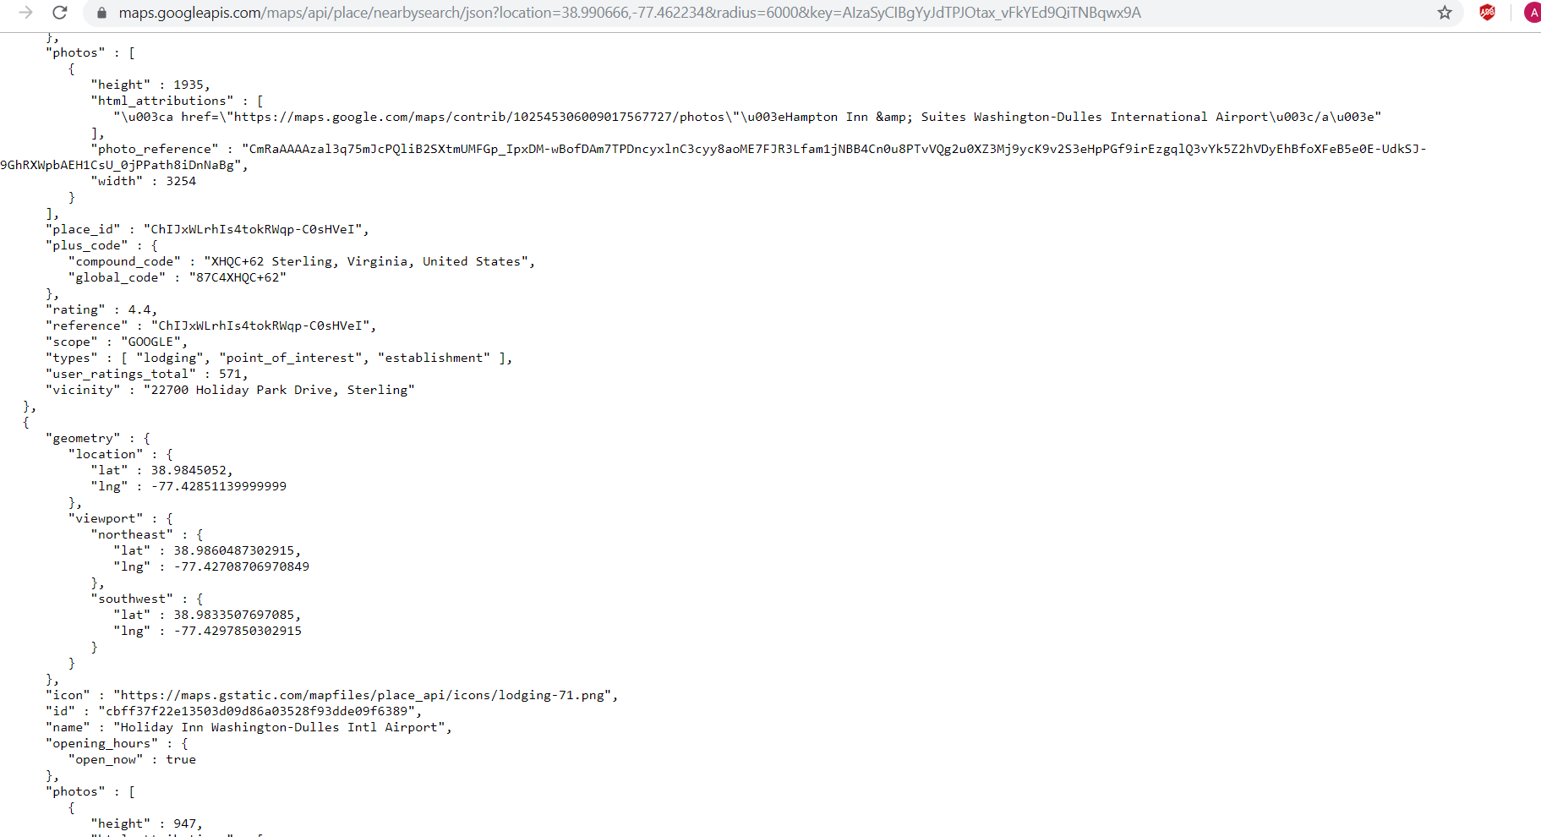
Google API Data

Slide 5
Parsing the Data
JavaScript Object Notation
Attribute-value pairs
Array data types
String.split() method
String.contains() method
Some data had to be converted
String.valueOf()

Slide 6
Data Classes and Inheritance
Location
Stores latitude and longitude
Step
Stores start location, end location, distance, and duration of each step in the navigation
MeetingPlace extends Location
Also stores name, address, placeType, and starRating
Restaurant extends MeetingPlace
Also stores dollarRating
GasStation extends MeetingPlace
Also stores gasPrice
Notes:
Adam

Slide 7
Methods Developed
URLrequest()
Requests a URL from Google Maps APIs
parseData()
Stores navigation steps into an array of objects from a “Step” class
findMidpoint()
Find the coordinate location of the midpoint
findMeetingPlaces()
Finds locations around the calculated midpoint
Notes:
Zain

Slide 8
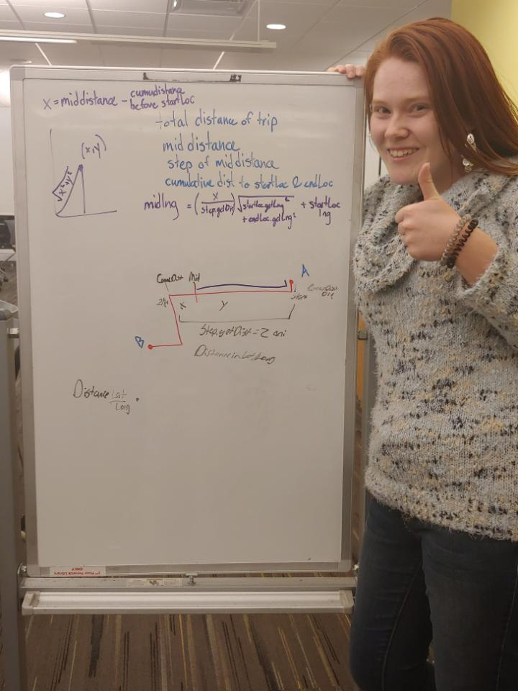
Calculating the Midpoint – Our Formula
Problem: We need to find the latitude and longitude coordinates of the midpoint.
Idea: The midpoint occurs between one of the steps. We can use the start and end location coordinates of that step to find the midpoint.
Notes:
Catie

Slide 9
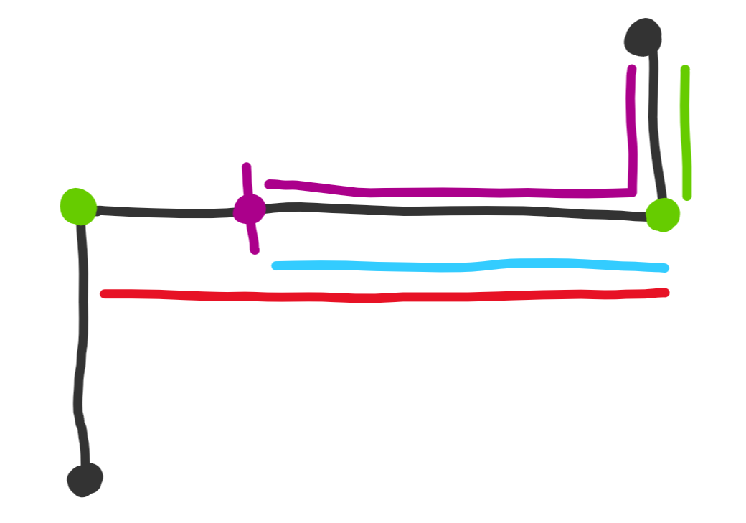
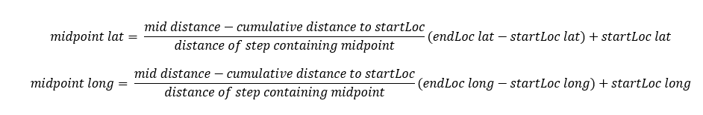
Calculating the Midpoint – Our Formula
endLoc
startLoc
Notes:
Catie

Slide 10
User Interface
Uses Basic User Interface made with Jframe
Features
Input
JButton
JTextField
Output
JText
ImageIcon
JLabel
Notes:
Willie

Slide 11
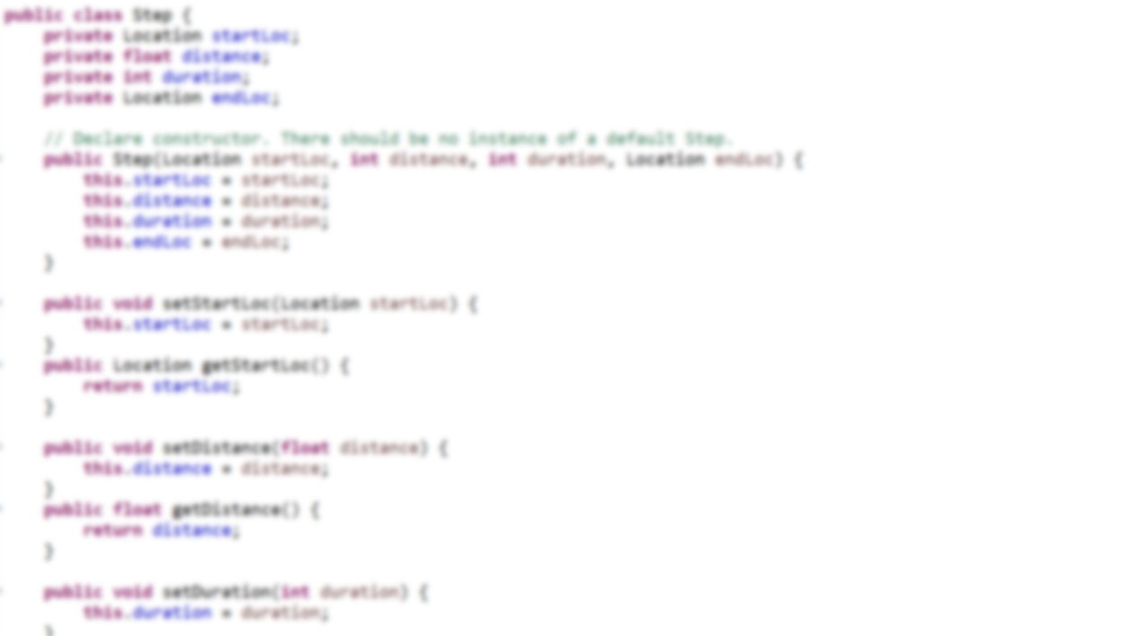
And now, a demonstration...

